Slide 1
CST 250 Microcomputer Architecture and Programming
Dr. Sohum Sohoni

Slide 2
Announcements and Reminders
Videos are available on a number of topics
Make sure that you watch the ones assigned with each of the projects
Piazza and the face to face interactions on Tuesday and Thursday are for answering any questions
Testing document should be included in final report
Grading is mostly up to date
Please let us know if you have questions about your grade, or need more feedback
Quiz 4 will be released today, due in a week

Slide 3
Notes from Reflections
Most were thoughtful and well-written
Weight for reflection shows its importance
In addition to reflecting, captures written communication
Do not underestimate the value of being able to write well
That is why grammar and quality of writing has a weight in the grade

Slide 4
Reflection
What is it?
It is an activity that we can engage in
Where we look back on lessons learned, knowledge gained, mistakes made, success achieved
To guide future actions
Why is it part of this class?
Should be part of any active learning class
Closes the loop- you don’t learn by doing unless you look back and reflect on what you did

Slide 5
Mindsets and Motivation
Research from Carol Dweck, Stanford University
How our mindset affects motivation, especially on challenging tasks
Notes:
This slide and the next one aren’t so much about this course, but they describe the philosophy behind my teaching and how I have set this class up. The basic idea is that you should be willing to try to work on challenging problems. Most of us have a fixed mindset, and quite often the environment in which we grew up reinforces this fixed mindset. We fear things that are new or and we stick to things that we know we will be good at. Try to break free of that.

Slide 6
Fixed vs Growth Mindset
People with a Fixed Mindset think
People with a Growth Mindset think
You are born with a certain level of intelligence, some talents, special skills
If you fail at something, it proves that your intelligence or skill was lacking
Difficult tasks suck because they expose your faults and incompetence- stay away
You can learn new skills, you can grow smarter, work on developing talent
If you fail at something, you need to work harder, improve your skills
Difficult tasks are great, ‘cause you can learn and grow- bring ‘em on
Notes:
Research has shown that one can move from having a fixed mindset to a growth mindset. It does not occur overnight, and I have personally tried this for a few years with some success. I do believe that life is better if you have a growth mindset.

Slide 7
Who has a fixed mindset?
I do, but am slowly changing (very slowly)
This is a deep change, not a superficial one
It is part of your overall growth
Why are we talking about this?
Belief that a college education shapes a person
Not just imparting technical knowledge or skills
Creating future generations of thoughtful, mindful citizens to lead innovation in this country and the world

Slide 8
So what does that mean for us?
If you got less than 50% on project 2, you should be spending a lot of time with us
You are probably struggling with project 3
With a fixed mindset you have concluded that
This course is too hard, or not well designed
Assembly language programming is for losers
I am not good at programming
I don’t belong in the software engineering program
We want to turn that around- we want you to succeed

Slide 9
Software Development Cycle
Don’t start coding right away
Read the assigned task
Discuss it with the client to see if your interpretations match
Design a solution or an algorithm
Implement pieces and test them, one piece at a time

Slide 10
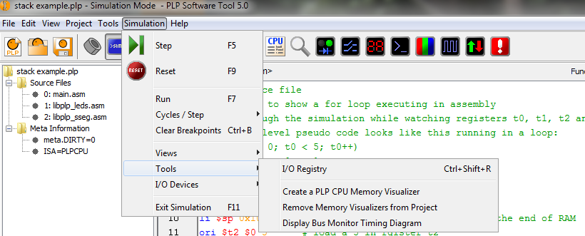
Memory Visualizer
In case you are wondering about the memory visualizer on the right in the previous slide…
It takes a base address and a signed offset
I set the base to the end of RAM and had an offset of -32 to watch 8 locations of the stack

Slide 11
Functions, call, return, JAL, JR
Pseudo-ops call and return mimic high-level function calls and returns
Allow us to go back to where we called a routine from
Arguments are passed, but through the ‘a’ registers
Return value done through ‘v’ registers
Call and return can be expensive
You can use jump and link (jal) in conjunction with jr instead (beware that registers are not saved by these instructions)

Slide 12
Multiple asm files
Not something to be scared of
PLPTool assembler will put the first line of assembled code from the second asm file at PC+4
What does that mean?
Let’s take a look

